Slide 1
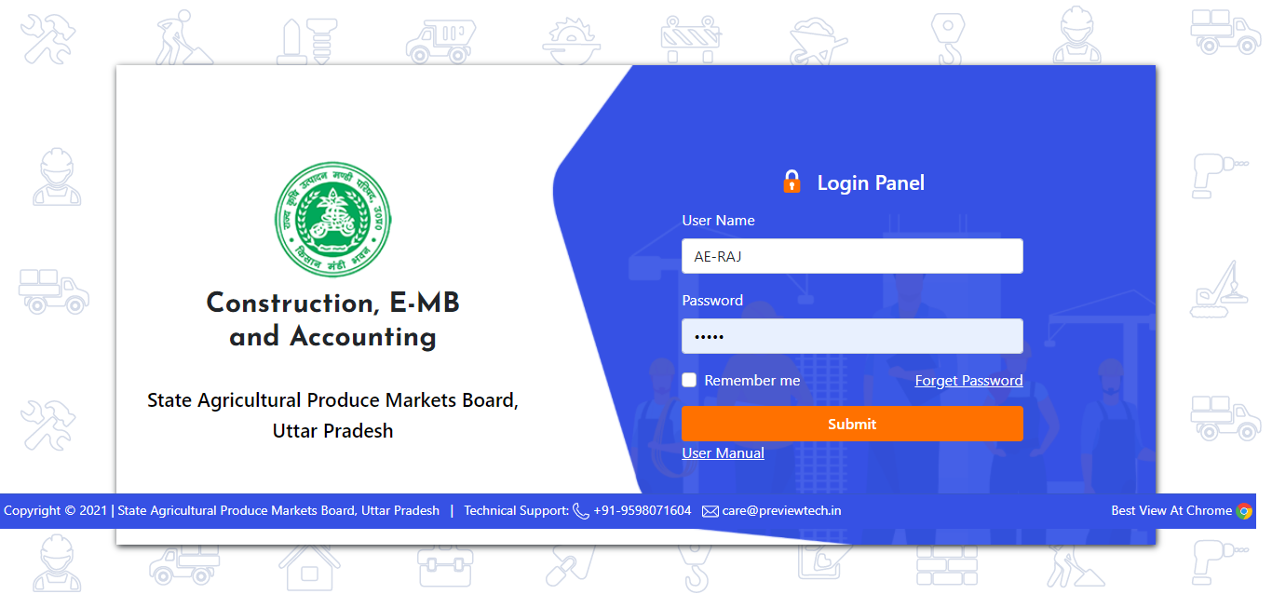
Start Working A.E
For Approve “e-MB”
Enter A.E. Username & Password

Slide 2
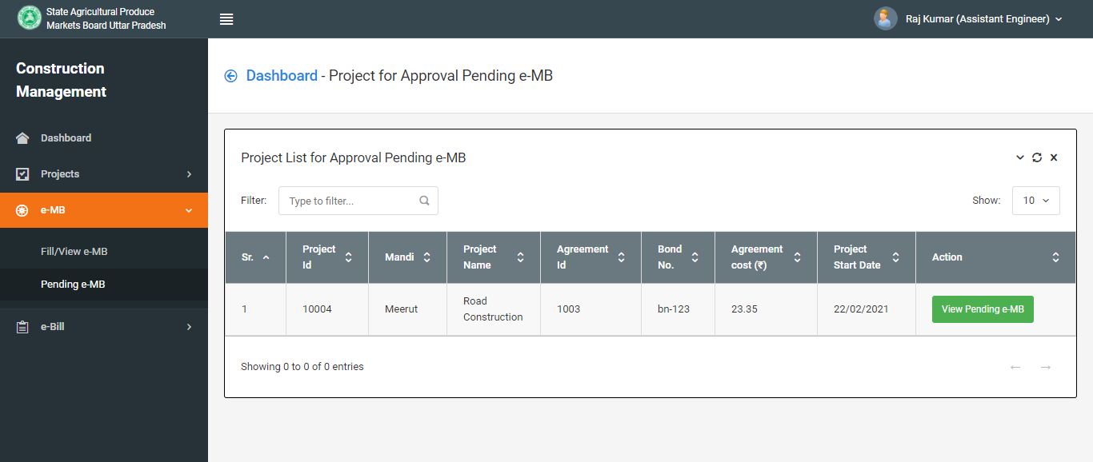
Click to View Pending e-MB on your project

Slide 3
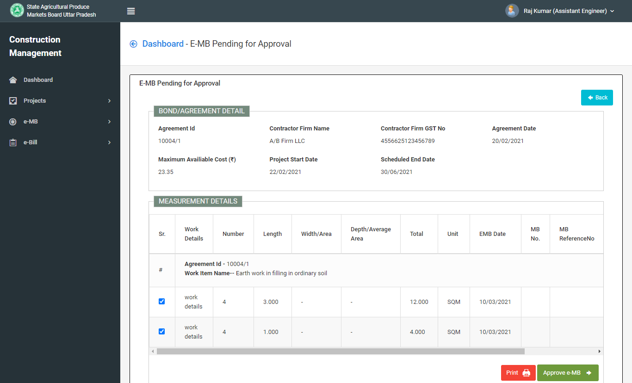
Click on Approve e-MB Button

Slide 4
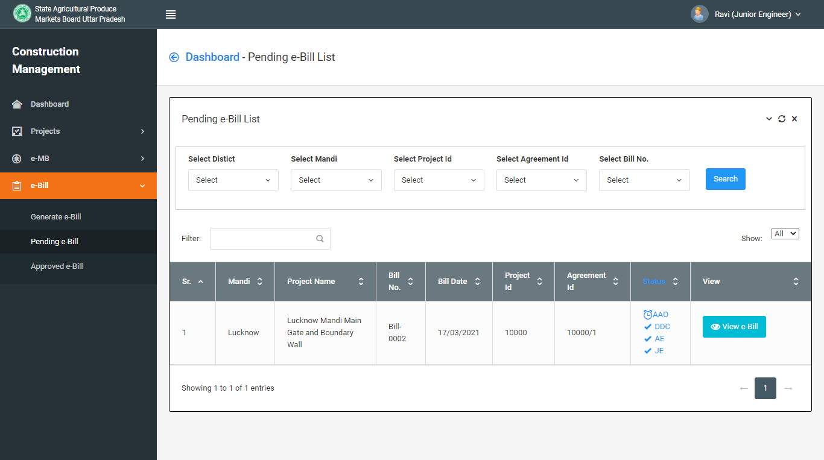
Bill Approval.

