Slide 1
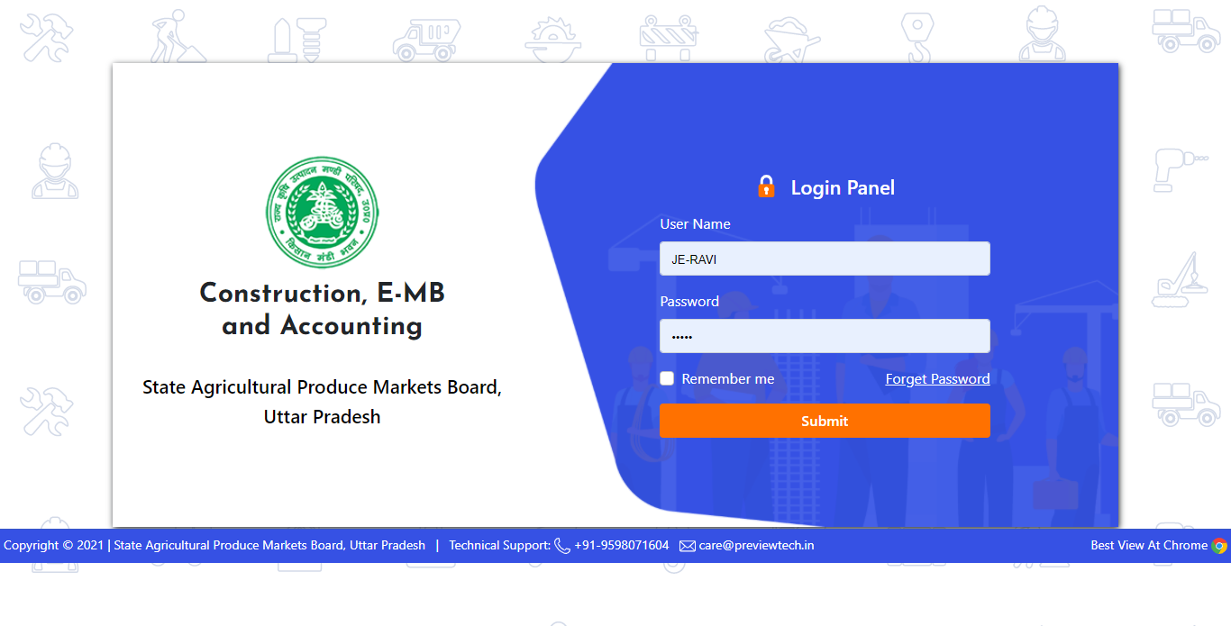
Start Working J.E
For Fill “e-MB”
Enter J.E. Username & Password

Slide 2
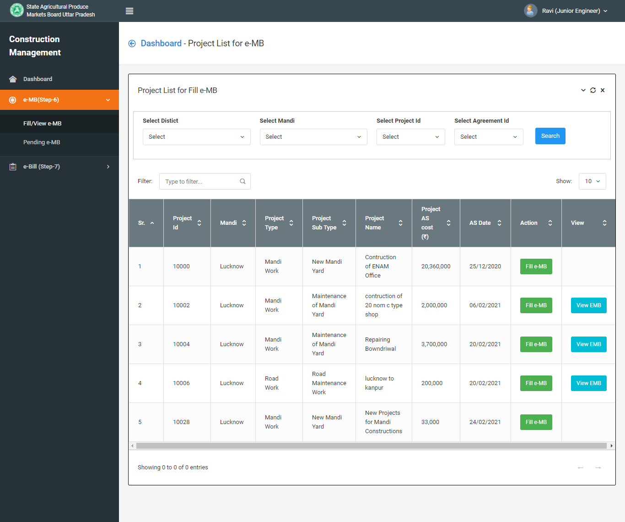
Click on “Fill e-MB” button to your Project.

Slide 3
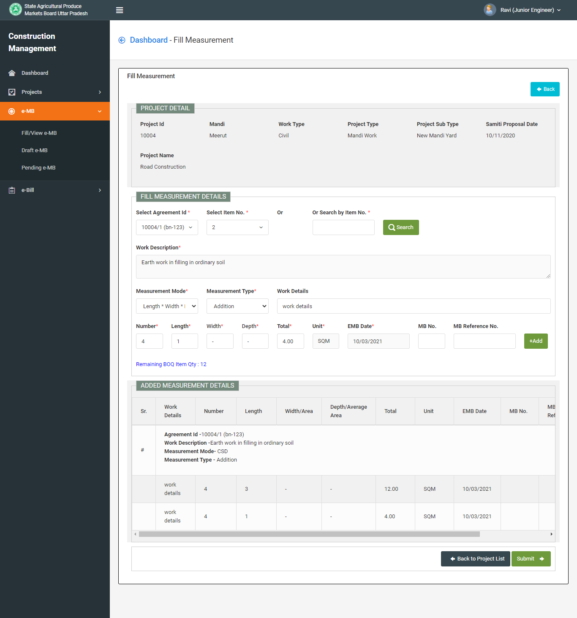
Fill all fields for “Fill e-MB” and Submit.

Slide 4
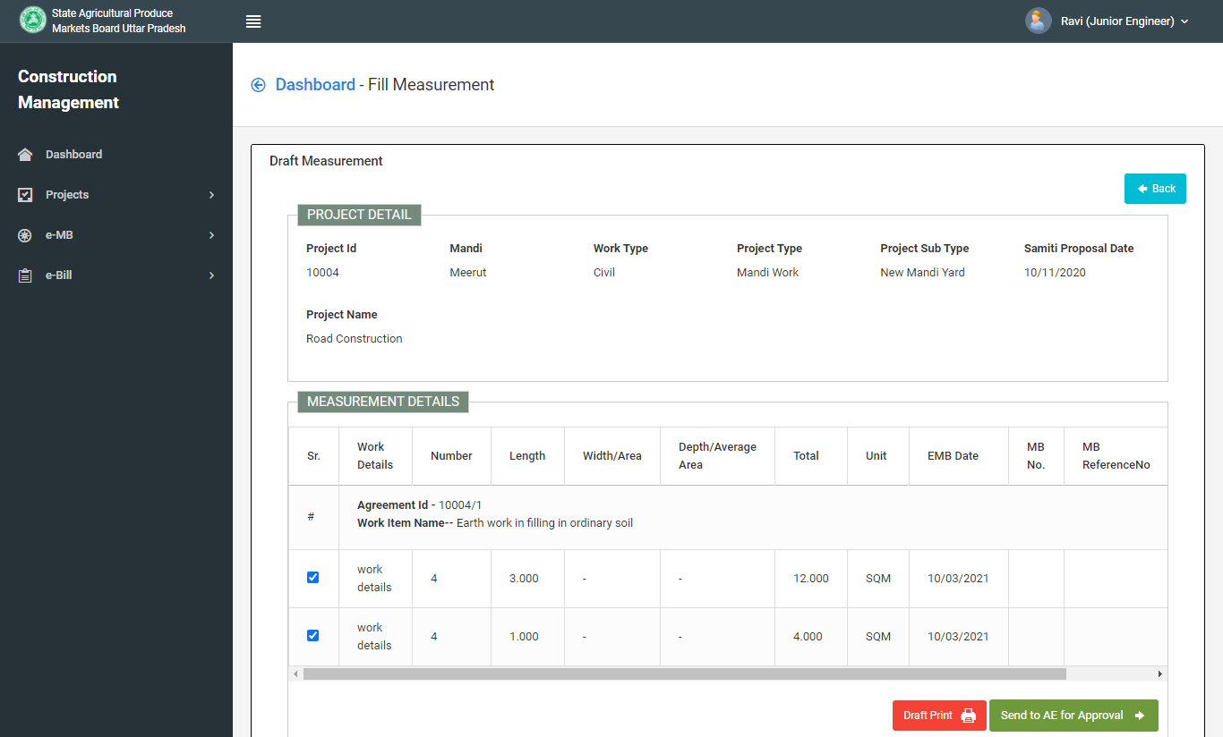
After submit click on “Send for Approval to A.E.”

Slide 5
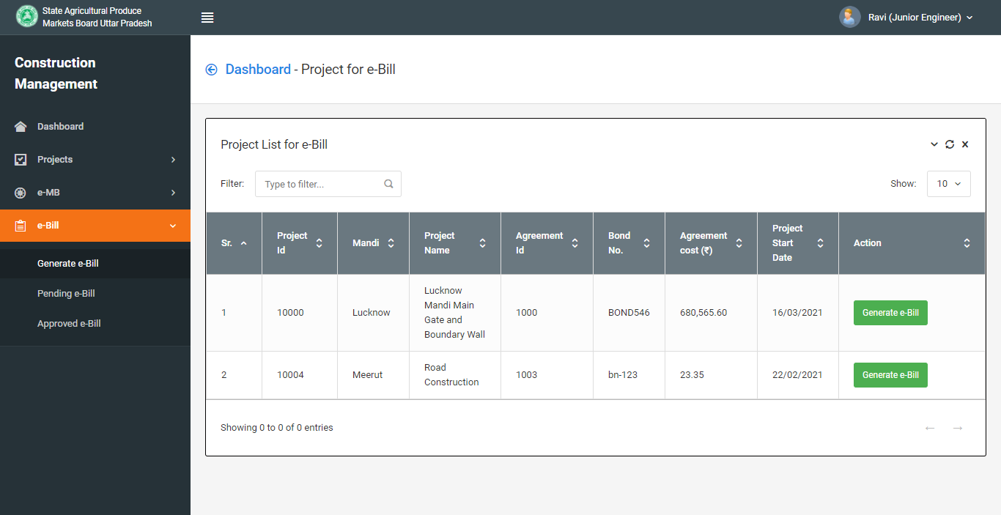
After Approval e-MB By A.E.
Click on Generate e-Bill for Generate Bill

Slide 6
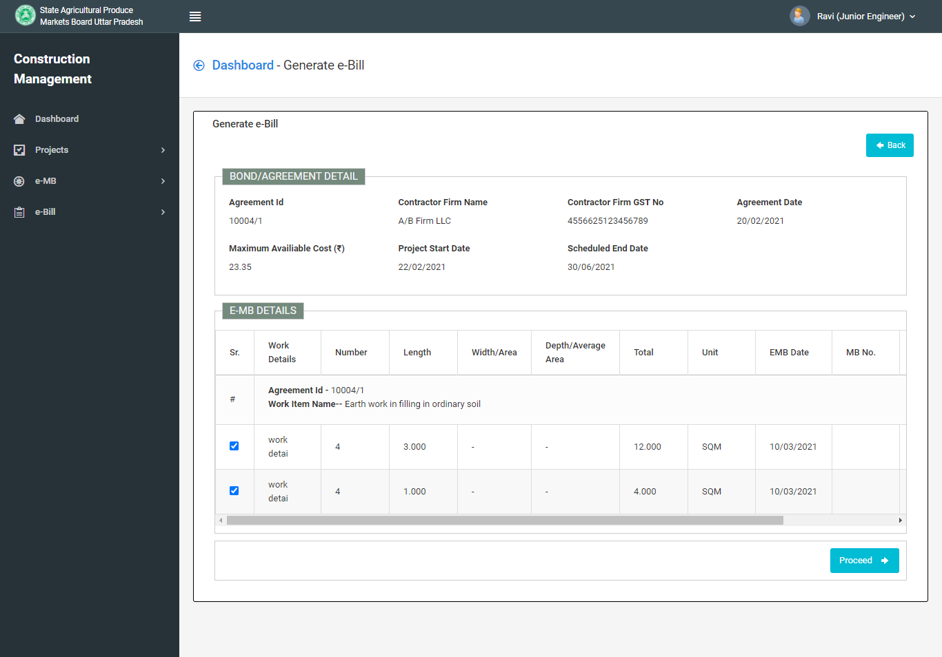
Click on e-MB rows and Proceed

Slide 7
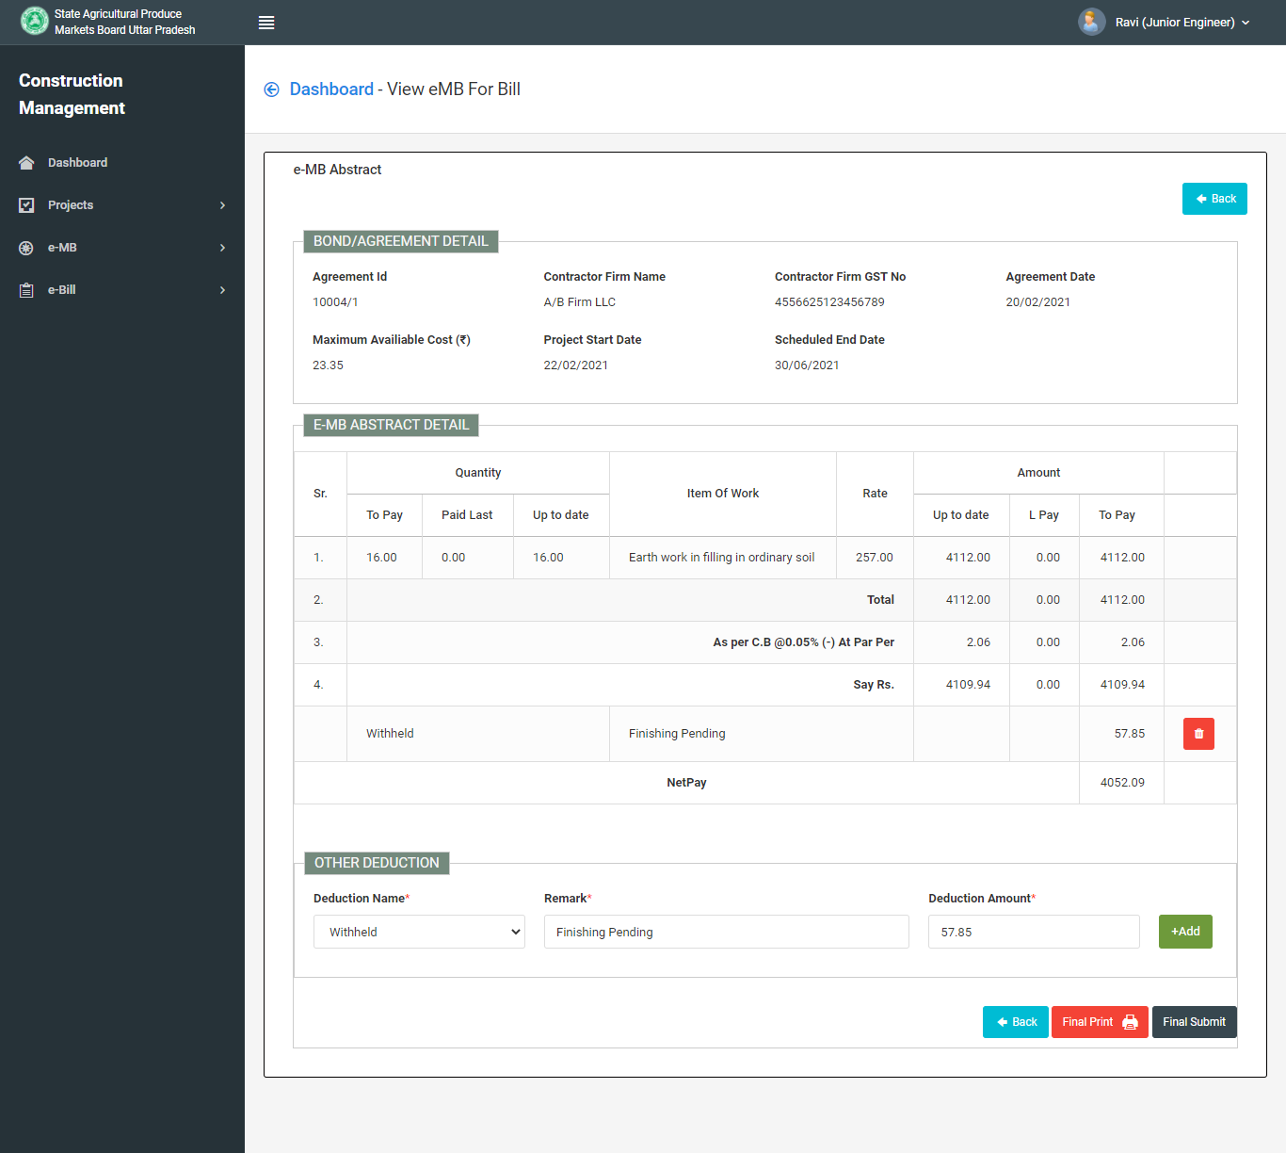
You can use Other Deductions for add in Bill & Click on Final Submit

Slide 8
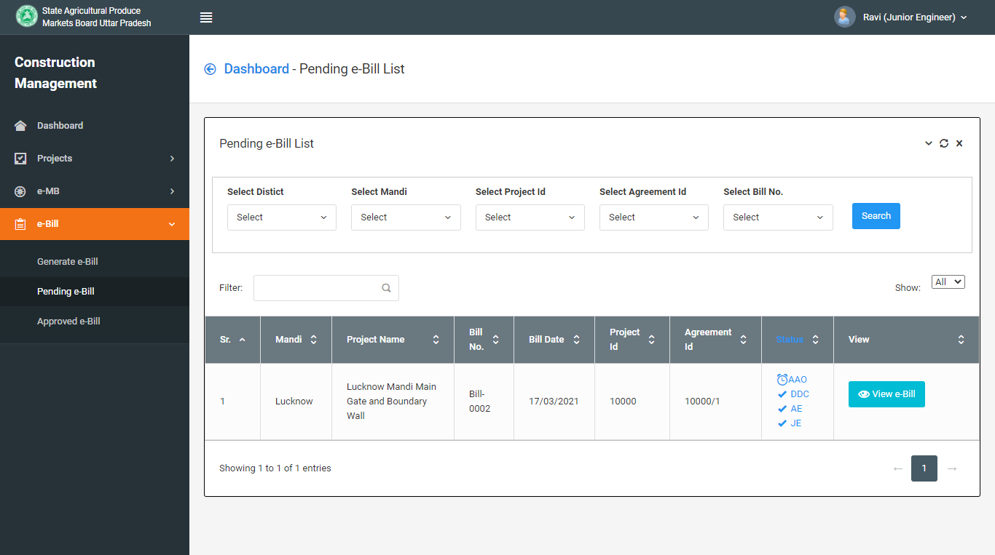
Bill has been generated.

